Slide 1
OCR for text detection and recognition
Test on drug packages from Google images

Slide 2
Crawled images from drug list
ABIES NIG.
ACETAMINOPHEN
ACONITUM NAP.
ACONITUM NAPELLUS
ACYCLOVIR
ADAPALENE BENZOYL PEROXIDE
ADRENALINUM
ALBUTEROL SULFATE
ALLIUM SATIVUM
ALUMINUM CHLORIDE
AMIKACIN SULFATE
AMITRIPTYLINE HYDROCHLORIDE
AMMONIA INHALANTS

Slide 3
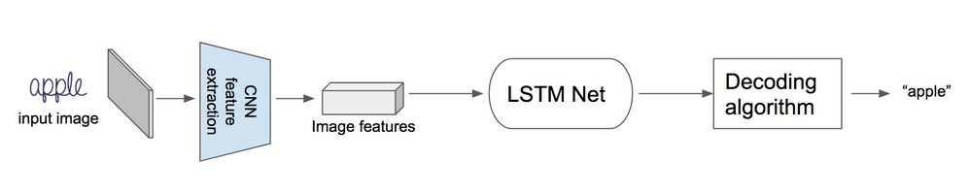
OCR(Optical character recognition) using deep learning
Popular CNN-LSTM Architecture
A small demo for explanation

Slide 4
Popular OCR Engines:
tesseract - The definitive Open Source OCR engine Apache 2.0
ocropus - OCR engine based on LSTM, Apache 2.0
ocropus 0.4 - Older v0.4 state of Ocropus, with tesseract 2.04 and iulib, C++
kraken - Ocropus fork with sane defaults
Ocrad - The GNU OCR. GPL
digit - OCR for numbers in meter displays, such as a power meter, using caffe
ocular - Machine-learning OCR for historic documents
SwiftOCR - fast and simple OCR library written in Swift
attention-ocr - OCR engine using visual attention mechanisms
RWTH-OCR - The RWTH Aachen University Optical Character Recognition System
simple-ocr-opencv and its fork - A simple pythonic OCR engine using opencv and numpy

Slide 5
Data preprocessing
Exclude drug unrelated images
Remove samples with text less than 10 chars
Remove samples has text more than 200 chars
Finally 104 images left

Slide 6
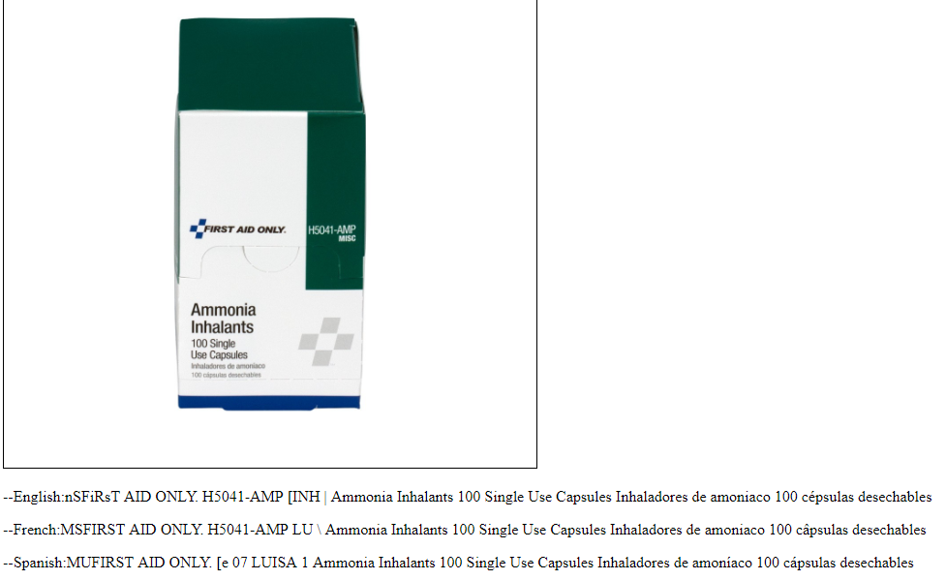
Tesseract recognition result samples

Slide 7
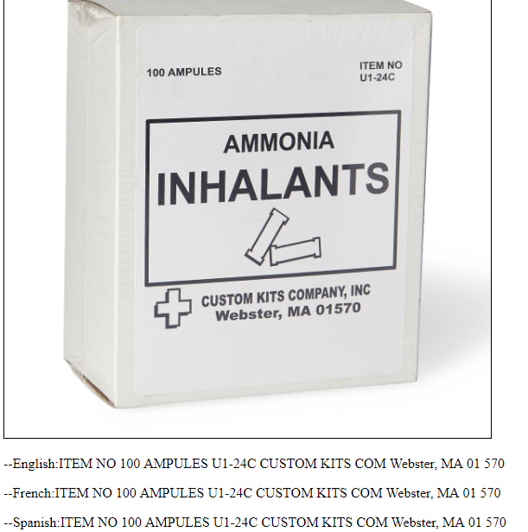
Tesseract recognition result samples

Slide 8
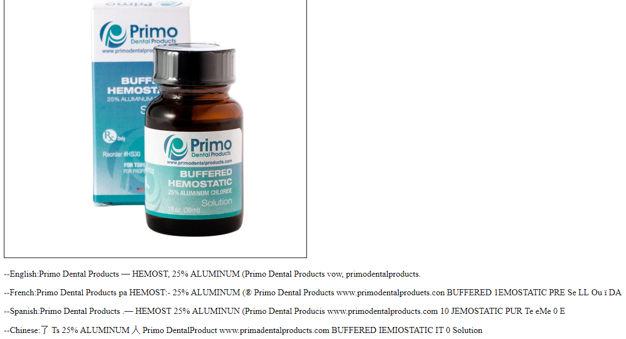
Tesseract recognition result samples

Slide 9
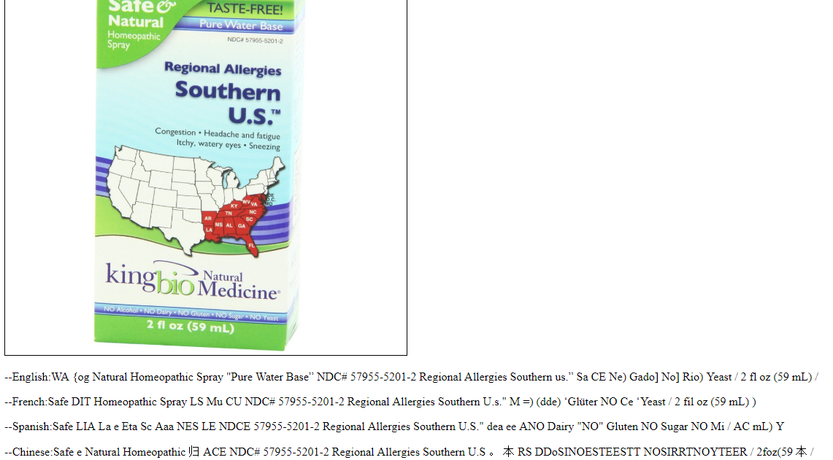
Tesseract recognition result samples

Slide 10
String similarity
Project on github: fuzzywuzzy
Methods from Fuzzywuzzy:
Simple Ratio
Partial Ratio
Token Sort Ratio
Token Set Ratio

Slide 11
Similarity matrix based on English
Pair of images
 | 0 | 1 | 2 | 3 | 4 | 5 | 6 | 7 | 8 | 9 | 10
0 | 100 | 87 | 30 | 55 | 34 | 22 | 27 | 24 | 23 | 22 | 28
1 | 87 | 100 | 25 | 61 | 37 | 23 | 27 | 23 | 22 | 22 | 20
2 | 30 | 25 | 100 | 26 | 17 | 33 | 17 | 36 | 23 | 33 | 26
3 | 55 | 61 | 26 | 100 | 31 | 19 | 21 | 18 | 21 | 33 | 18
4 | 34 | 37 | 17 | 31 | 100 | 26 | 21 | 20 | 23 | 17 | 20
5 | 22 | 23 | 33 | 19 | 26 | 100 | 24 | 22 | 13 | 28 | 21
6 | 27 | 27 | 17 | 21 | 21 | 24 | 100 | 34 | 26 | 33 | 18
7 | 24 | 23 | 36 | 18 | 20 | 22 | 34 | 100 | 26 | 39 | 17
8 | 23 | 22 | 23 | 21 | 23 | 13 | 26 | 26 | 100 | 22 | 36
9 | 22 | 22 | 33 | 33 | 17 | 28 | 33 | 39 | 22 | 100 | 33
10 | 28 | 20 | 26 | 18 | 20 | 21 | 18 | 17 | 36 | 33 | 100
103
103

Slide 12
Top 5 similarity score for every row
 | Top 1 | Top 2 | Top 3 | Top 4 | Top 5
0 | 87 | 55 | 47 | 38 | 38
1 | 87 | 61 | 47 | 38 | 38
2 | 42 | 36 | 35 | 33 | 33
3 | 61 | 55 | 42 | 36 | 36
4 | 44 | 43 | 40 | 40 | 40
5 | 46 | 38 | 36 | 33 | 32
6 | 37 | 34 | 33 | 32 | 31
7 | 46 | 39 | 38 | 38 | 36
8 | 36 | 33 | 32 | 32 | 31
9 | 50 | 44 | 40 | 39 | 39
10 | 83 | 62 | 36 | 36 | 33
11 | 66 | 42 | 36 | 35 | 35
12 | 39 | 35 | 35 | 34 | 32
13 | 32 | 32 | 31 | 31 | 29
14 | 90 | 37 | 34 | 33 | 32
15 | 32 | 31 | 31 | 31 | 30
16 | 74 | 44 | 40 | 34 | 33
17 | 44 | 36 | 36 | 36 | 32
18 | 44 | 39 | 35 | 32 | 32
19 | 74 | 47 | 47 | 47 | 47
103

Slide 13
Classification of top 5 results
For each images, get similarity scores with all other images
Rank and get top 5 results has highest similarity score for each image
If all top_5 has the same label, accuracy is 100%
If 4 of top_5 has the same label, accuracy is 80%

Slide 14
Accuracy of top 5 score results
Details are displayed in following slides

Slide 15
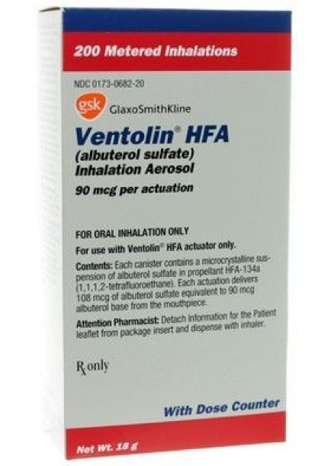
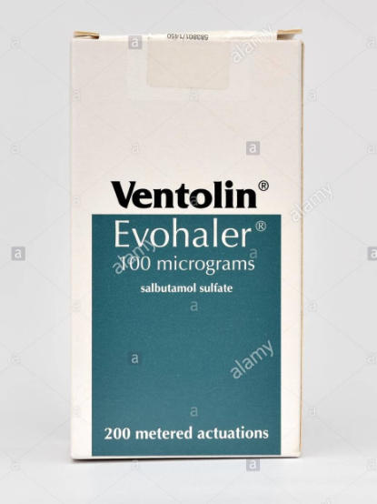
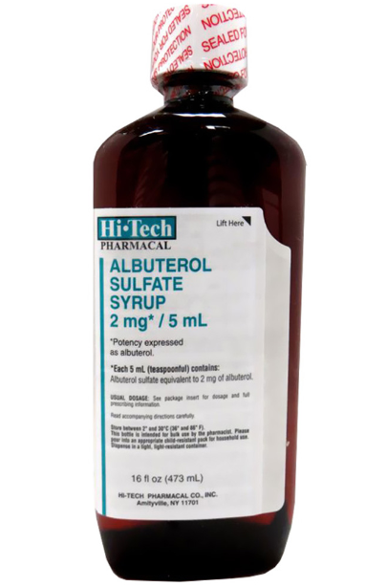
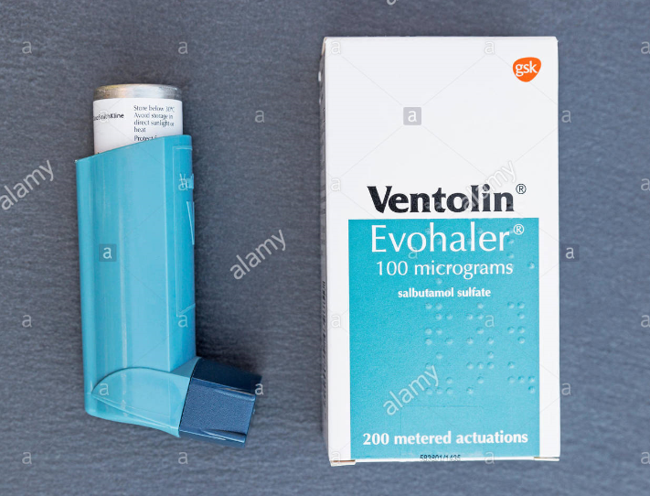
Selected Image result with high accuracy
Similarity Score
46
Similarity Score
39
Similarity Score
38

Slide 16
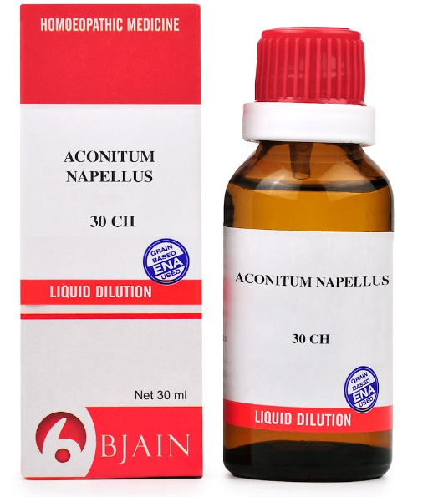
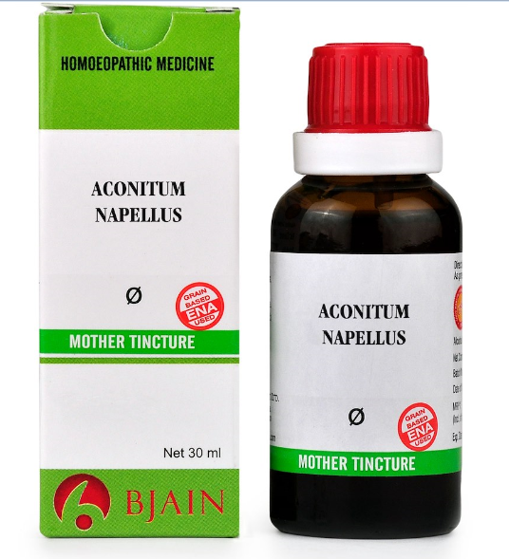
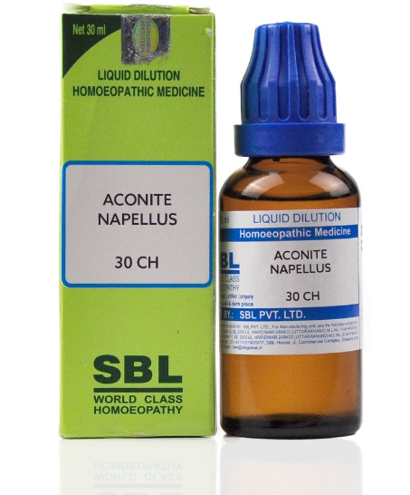
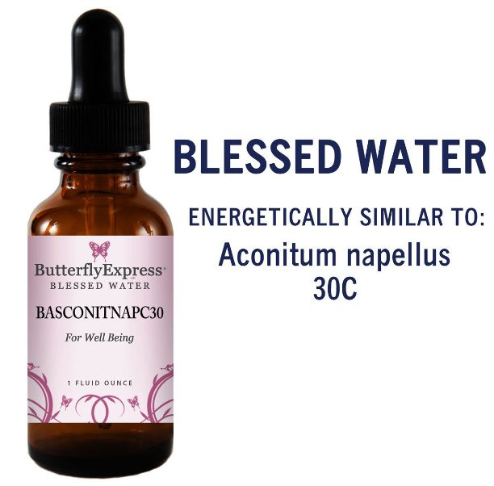
Selected Image result with high accuracy
Similarity Score
87
Similarity Score
53
Similarity Score
39

Slide 17
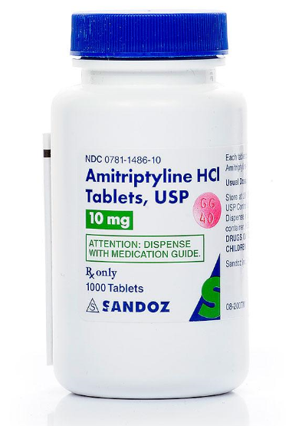
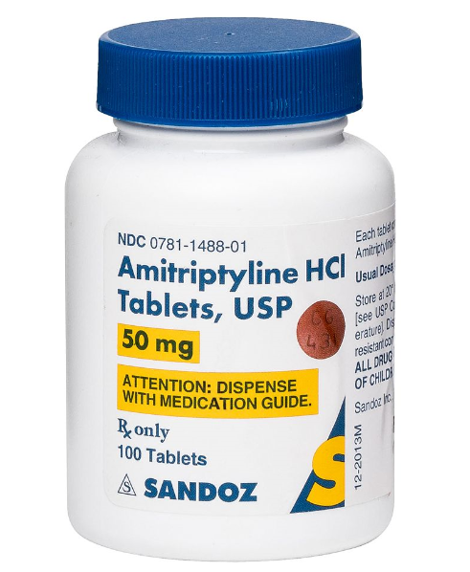
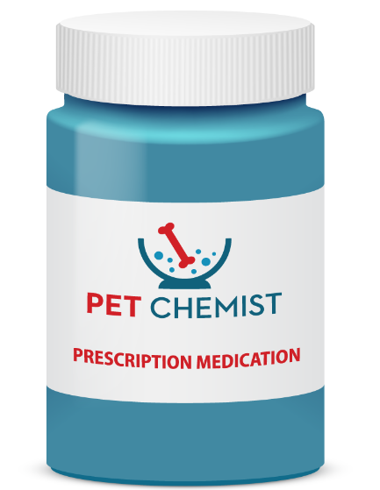
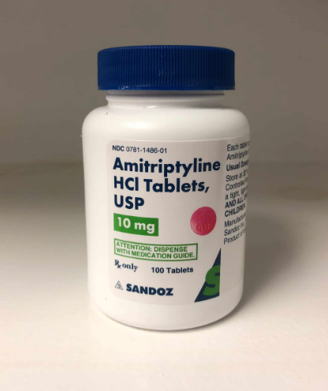
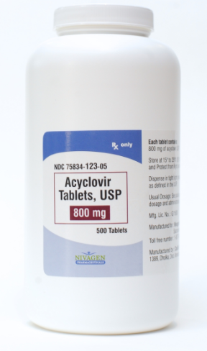
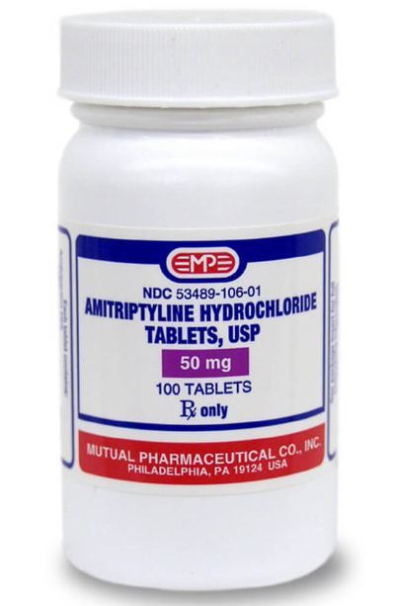
Selected Image result with high accuracy
Similarity Score
68
Similarity Score
53
Similarity Score
49
Similarity Score
44
Similarity Score
37

